Slide 1
Secure Data Hiding in Image Using Steganography
Presented By:
Student Name : K. VISHNU VARDHAN
College Name & Department : INSTITUTE OF AERONAUTICAL ENGINEERING
ECE

Slide 2

OUTLINE
Problem Statement
Technology used
Wow factor
End users
Result
Conclusion
Git-hub Link
Future scope

Slide 3

Problem Statement
Need for secure and hidden communication.
Conventional encryption techniques may be easily detected.
Hiding messages in images makes communication stealthy and less suspicious.

Slide 4
Technology used
Programming Language: Python 🐍
Libraries Used:
OpenCV – For image processing.
OS Module – For file handling.
String Module – For character encoding.

Slide 5
Wow factors
What Makes This Project Unique?
Hides text inside an image without changing its visible appearance.
Works without special software, just Python and OpenCV.
Can be used for covert communication in a secure way.
Unlike traditional encryption, hidden data does not attract attention.
Uses basic pixel manipulation, making it lightweight.

Slide 6
End users
Who Can Benefit from This Project?
Government & Intelligence Agencies – Secure communication. Cybersecurity Experts – Protect sensitive information. Journalists & Whistleblowers – Conceal critical messages. Businesses – Prevent industrial espionage. Students & Researchers – Learn about cryptography & security.

Slide 7
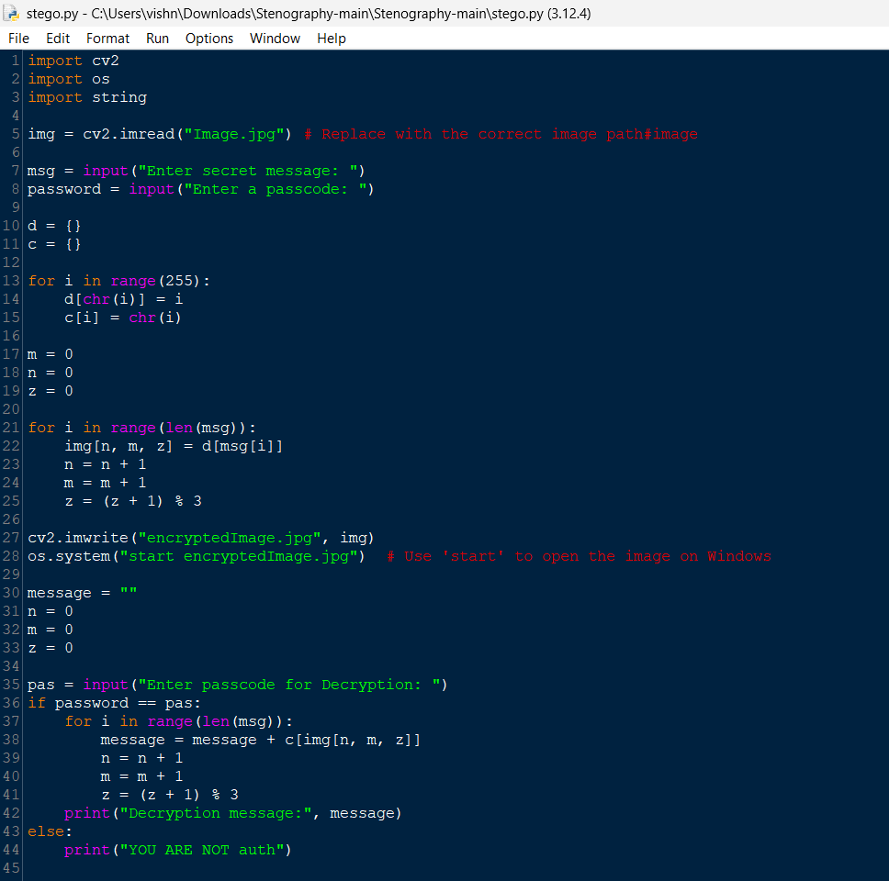
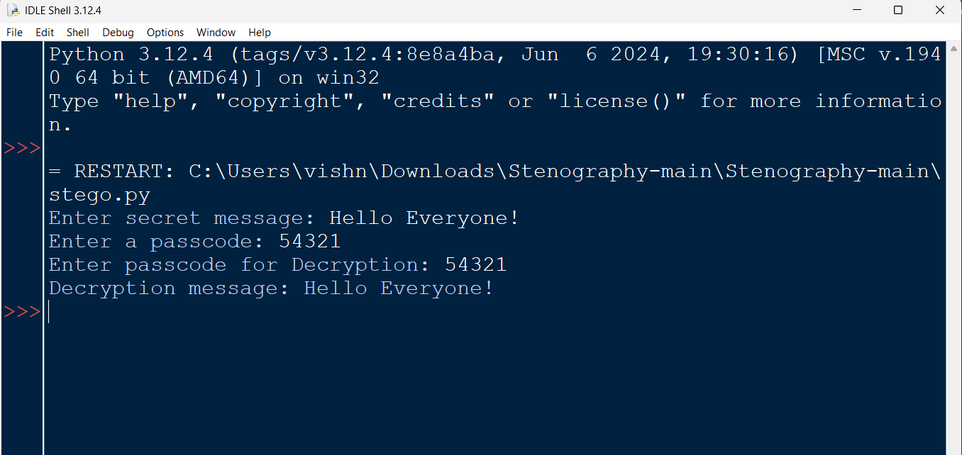
Results

Slide 8
Conclusion
This project successfully demonstrates image-based steganography.
It provides a secure way to embed secret messages inside an image.
The method is simple, lightweight, and effective for basic hidden communication.
Future improvements can enhance security & efficiency.
“ Steganography is the future of hidden communication! ".

Slide 9
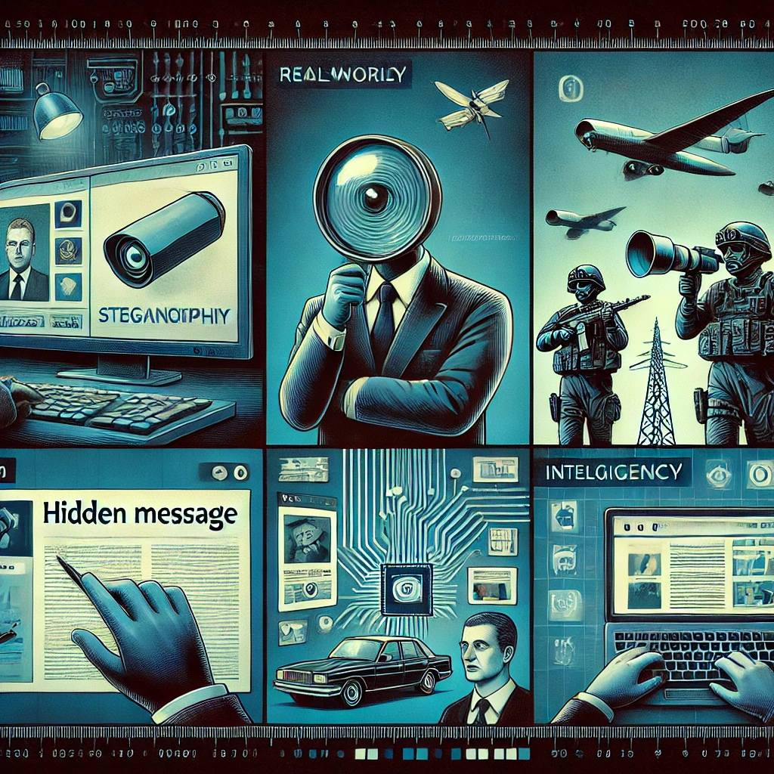
GitHub Link
https://github.com/Vishnu-000/Steganography.git

Slide 10
Future scope(optional)
Use LSB (Least Significant Bit) Encoding for better efficiency.
Implement AES Encryption before hiding the message.
Develop a GUI version for non-programmers.
Allow multi-image encryption to store larger messages.
Integrate AI for automated detection & protection against steganalysis.

Slide 11

THANK YOU

